Slide 1

Capstone Project Phase 1
Camera measurement of physiological vital signs monitoring system
Supervisors: Dr. Dan Lemberg and Mrs. Elena Kramer
Students: Shimon Rubin and Lior Guzovsky

Slide 2
Table of content
Background & Research
Solution
Application Architecture
GUI
Verification plan
Challenges

Slide 3
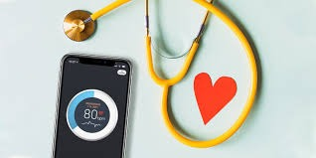
Background
Personal story as an inspiration
Traditional monitoring heart rate methods VS. Contactless monitoring
Desired outcome
Notes:
1. From a personal story of a family member who was in a nursing home, we have noticed that the therapist-patient ratio during the night shifts is relatively small and therefore dangerous for the patients
2. Traditional methods use contact-based devices like pulse oximeters for vital sign measurement. However, these methods can be intrusive and uncomfortable, especially for elderly individuals in nursing homes, In addition, the traditional methods demand more therapists which is a problem we won’t be able to solve.
2. Monitoring heart rate from video data has become a popular research area for non-contact vital sign measurement
3. Our desired outcome is a real time monitoring Application
4. Accurate and timely monitoring of heart rate is vital in the medical field for diagnosing and managing cardiovascular conditions

Slide 4
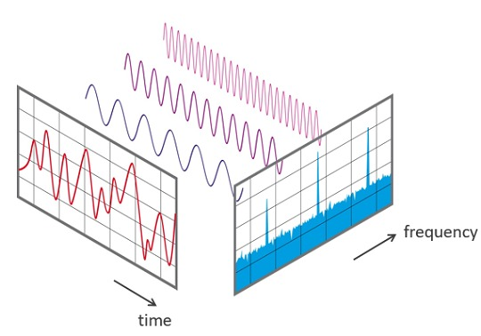
Research
Reading papers regarding vital sign extraction
Understanding relevant medical background
Deeper research into suggested methods
Tools for application development for part B
Notes:
1. We have read 6 articles regarding vital sign extraction which helped us focusing over the methods we may use to extract heart rate from video
2. Cardiovascular system transports blood and consists of the heart, blood vessels, and blood Hemoglobin, found in red blood cells, transports oxygen from lungs to tissues Oxygenated blood is carried by arteries, while deoxygenated blood returns to the heart through veins Heart contracts and relaxes rhythmically, pumping blood during systole and allowing flow back during diastole Blood circulates through arteries, capillaries, and veins in a continuous loop Major arteries supplying blood to the face and head are carotid arteries and vertebral arteries Normal heart rate ranges between 60-100 beats per minute at rest (1-1.67 Hz)
3. Apart from reading the articles, we delved into each topic individually, immersing ourselves in the intricacies of techniques such as Fast Fourier Transform (FFT) and Haar cascade classifier to gain a deeper knowledge and understanding how they work.
4. We understood that our main lib that will be used is the application development process is open CV (CV2) in py. ,therefor we’ve searched for a GUI lib in py and found that pyQT5 is very useful for building the GUI part

Slide 5
Solution

Slide 6
Pipeline
Input video
Locate Eyes
Locate ROI
Notes:
1. Receiving video input - The system should be able to receive both live and recorded video streams as input.
2. Locating the eyes using the Haar cascade classifier - An efficient machine learning approach for identifying objects, such as face traits like eyes, is the Haar cascade classifier. The goal is to precisely identify the eyes in the video frames.
3. Locating the Region of Interest (ROI) - Once the eyes have been located, the algorithm should move on to choose the forehead as the ROI because it frequently offers a good location for detecting the pulse (related to the hemoglobin we explained earlier).

Slide 7
Pipeline
Color space
Frequency domain space
Locate peaks
Notes:
4. Address the green color channel - Convert the ROI image into a suitable color space, such as RGB (Red, Green, Blue). Split the ROI image into its component red, green, and blue color channels. Then, while working with the picture channels, access the green channel by choosing the proper index.
5. Perform FFT - Fast Fourier Transform, sometimes known as FFT, is a mathematical procedure that converts time-domain data into the frequency domain. The system expects to examine the signal's frequency components by applying the FFT to the extracted data. In addition, it contributes to the noise reduction in our input data.
6. Locating peaks in the necessary frequency range - The approach should locate peaks in a particular frequency band, often between 0.75 Hz and 4 Hz, within the converted frequency domain using bandpass filter. These peaks most likely represent heart rate indicators.

Slide 8
Pipeline
Count peaks
Calculate pulse
Result
Notes:
7. Counting peaks within a set time range - An estimate of the pulse rate can be obtained by the algorithm by counting the peaks within the given time and frequency ranges (time range of 15-30 seconds). It is assumed that the number of peaks reflects the number of heartbeats that took place within the specified period.
8. Calculation of the pulse - The algorithm should determine the patient heart rate based on the recognized peaks.
9. Result - The estimated pulse rate should eventually be displayed or visually represented in our GUI.

Slide 9
Application Architecture

Slide 10
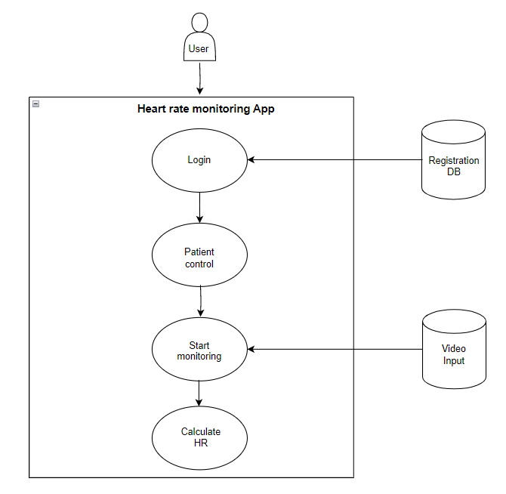
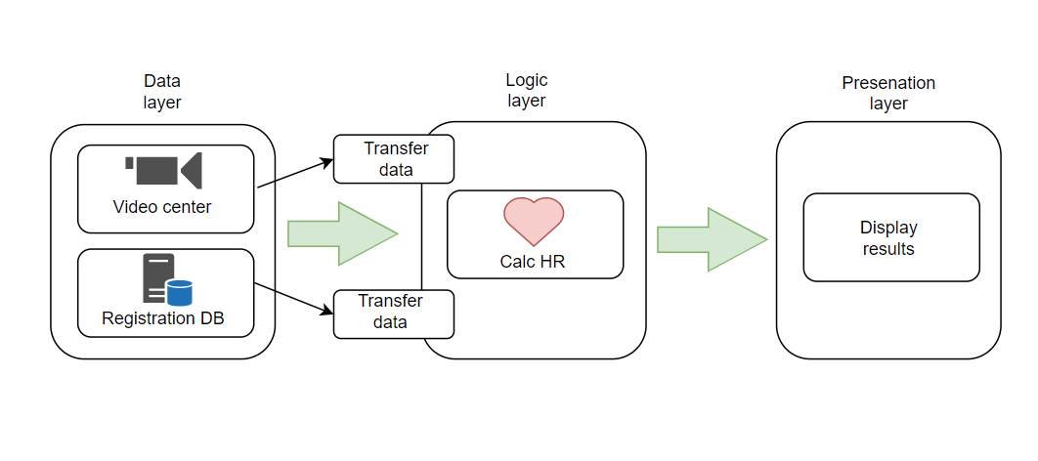
Overview Architecture
Notes:
Our architecture consists of several key components:
1.Heart rate monitoring application
2.Video input center which provides input data to the monitoring application
3.Registration DB for user authentication in the login phase and for patients information.
A heart rate monitoring application built using video analysis follows a similar architectural pattern known as the Model View Controller (MVC) architecture,
which consists of three distinct layers. The application's structure can be visualized in the following figure.
Our application will be using the MVC architecture in the following method:
1. Model
Our video center is responsible for sending the video input towards the logic layer where the data is analyzed.
The registration DB contains both authorized users and patients.
2. Controller
The controller layer will be responsible to analyze the data in real time, finding the ROI, extracting the signal, calculating the peaks and sum the result. In addition,
this layer is responsible for receiving the input video stream from the model layer.
3. View
The view layer is the interface layer where the user navigates between different panels and show different patients.
This layer will display the calculated HR from the controller layer and will present visualizations of the HR analysis.

Slide 11
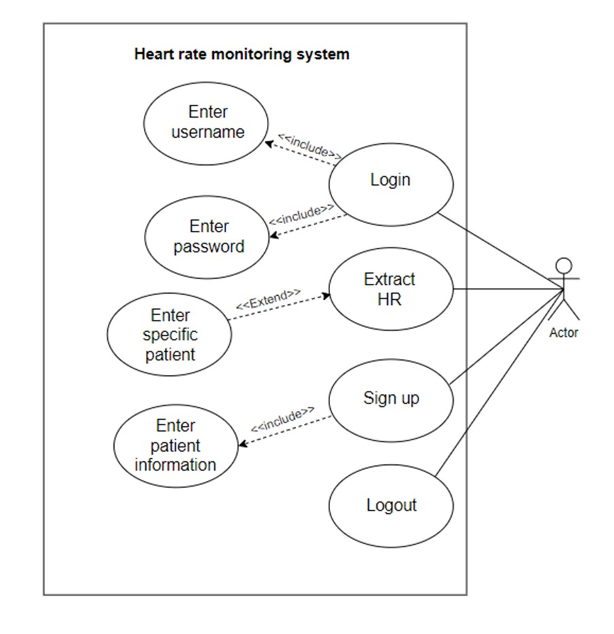
Use-Case
Notes:
Use CaseThe following use case diagram shows the users interaction with the system.

Slide 12
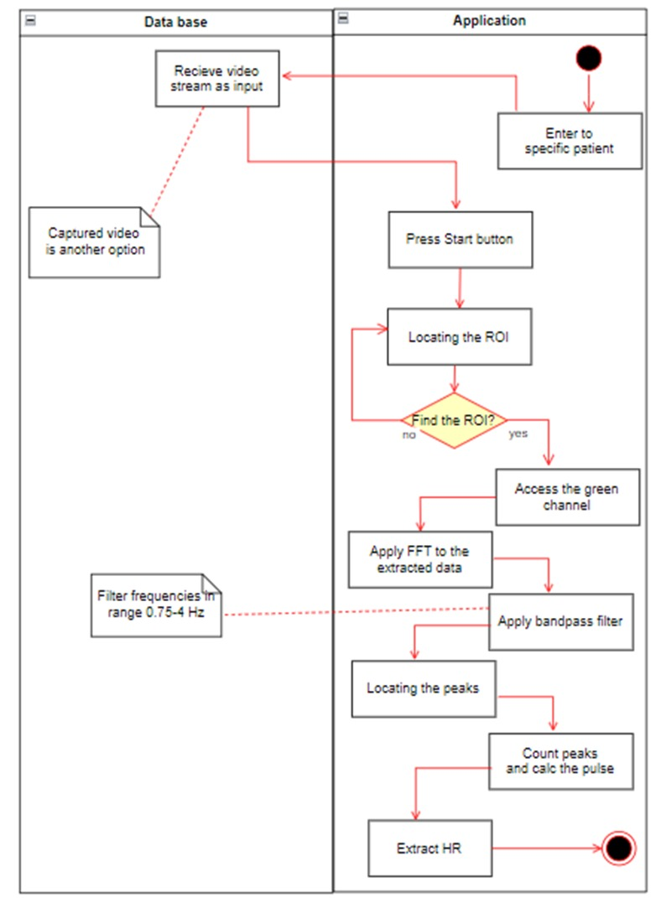
Activity
Notes:
Activity diagramThe following activity diagram shows the process of extracting heart rate from a chosen video input by the user, to the point it is shown to the user

Slide 13
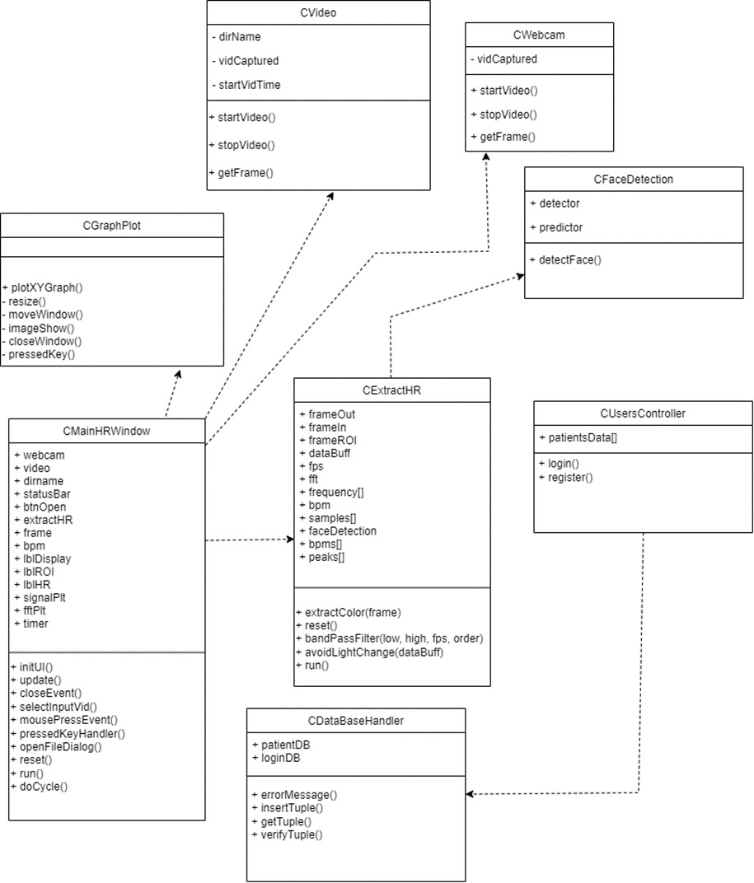
Class
Notes:
The following class diagram shows the connections and interactions among the key components involved in the process of determining pulse rate from video input.

Slide 14
Graphical User Interface

Slide 15
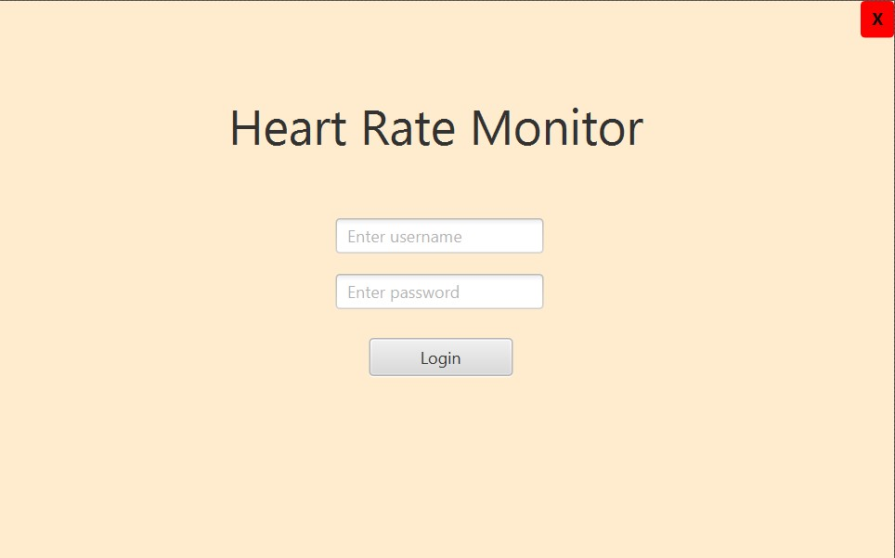
Notes:
The login page of the heart rate monitoring system created for nursing home staff members offers a safe and convenient way to access the system. Employees can validate their identification by entering their specific credentials, such as username and password. Only authorized workers can access the program and read sensitive information related to the residents' heart rate data, thanks to the login screen. It acts as the primary entry point to the system and supports data security, confidentiality, and privacy in nursing homes

Slide 16
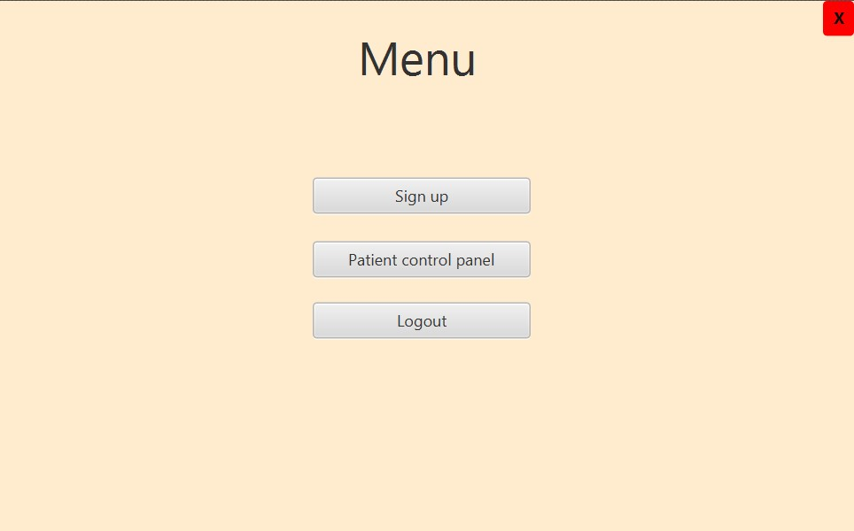
Notes:
The nursing home personnel can manage patient-related tasks effectively thanks to the menu of the heart rate monitoring application. The menu has three essential selections which are the above
3.The "Logout" button provides an easy way for the user to safely leave the system. The user can preserve their privacy and data by logging out of their account by clicking this button.
Nursing home employees may easily navigate the heart rate monitoring program, add new patients, retrieve patient information, and safely logout as needed through this user-friendly menu

Slide 17
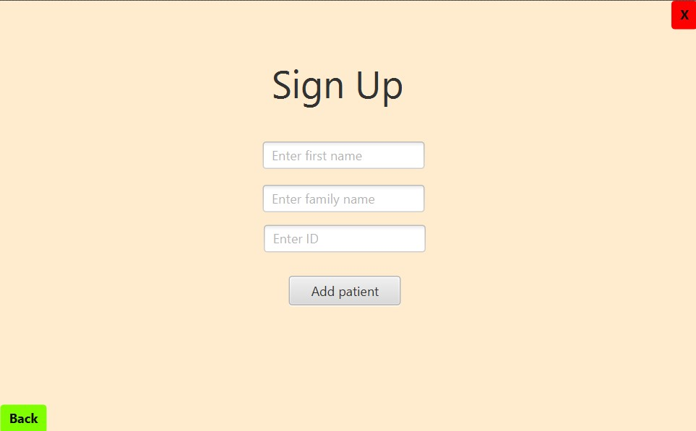
Notes:
1.The staff can easily register new patients in the system by selecting "Sign up new patient". Each new patient can have their information entered and a profile created by selecting this option, guaranteeing that they are included in the heart rate monitoring system.

Slide 18
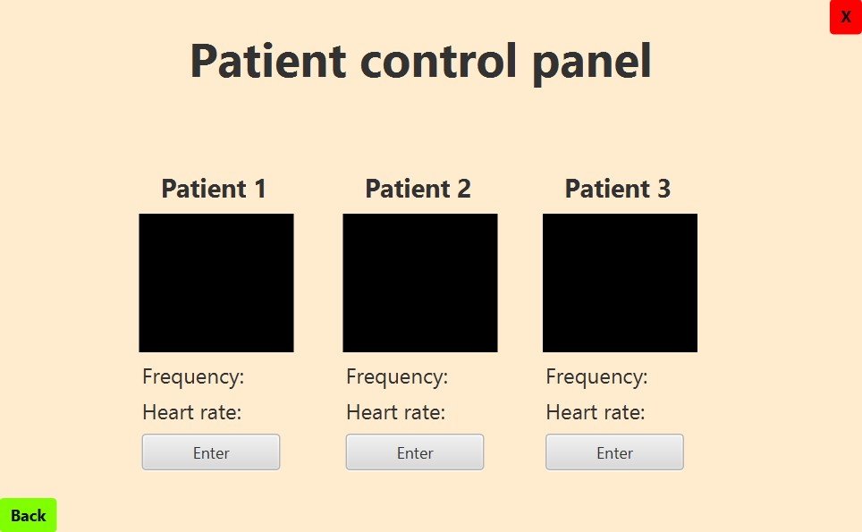
Notes:
2.Another dashboard called the "Patient Control Panel" shows a list of all patients. A tiny video feed displaying each patient's live facial footage is displayed next to their name.
The panel also displays the associated heart rate numbers, giving a brief overview of each patient's present heart rate state.

Slide 19
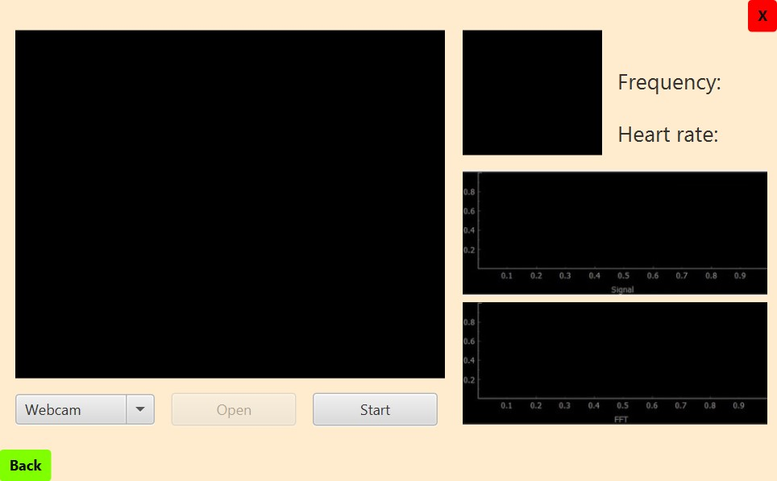
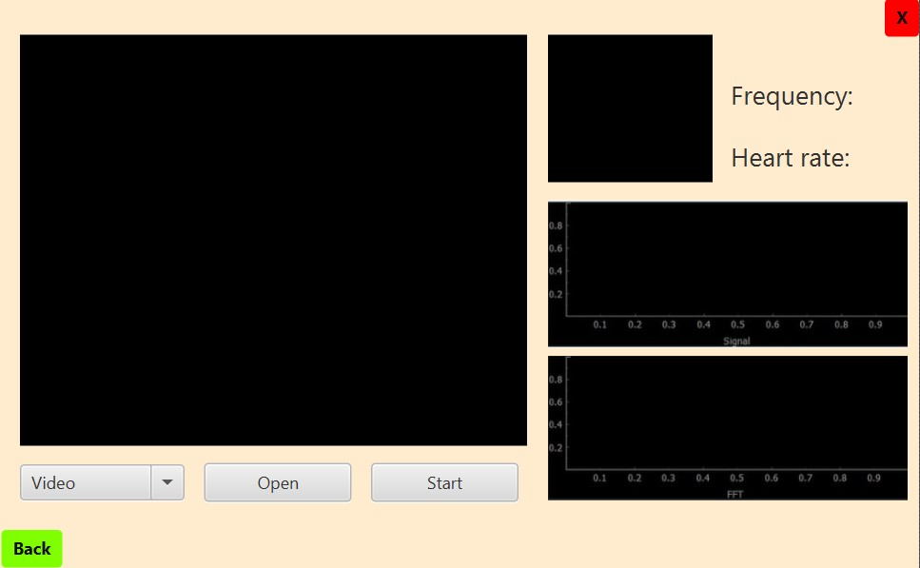
Notes:
The heart rate monitoring system opens a special window suited to that patient when a specific patient is selected from the control panel and the "Enter" button is pressed. Nursing home workers can access several crucial tools in this window to track the patient's heart rate. They are given the choice of uploading a previously recorded video or turning on the webcam to enter live video. This provides reliable heart rate analysis in real-time monitoring of the patient's facial region. The patient's current heart rate is also shown in the window, giving quick feedback on their cardiovascular health. The window also displays graphs that show the Fast Fourier Transform (FFT) and signal of the RGB (Red, Green, Blue) components to further assist in analysis. This makes it easier to understand the heart rate data and its underlying properties.

Slide 20
Verification Plan
Notes:
Testing plan for Heart Rate Monitoring Application and related database
Agile methodology for effective and iterative software delivery
Verify performance of the application and ensure accuracy and reliability of the database
Test cases listed in a table with test number, module, function, and anticipated outcome

Slide 21
Tests
Test | Module | Tested Function | Expected Result
1 | Login | User login | Only authorized users can login to the Application
2 | Registration | User registration | Registered user cannot be re-registered
3 | Face detection | Face detection accuracy | System accurately detects and locates faces
4 | Face detection | Low lightning | System accurately detects and locates faces
5 | Face detection | Different skin tones | System accurately detects and locates faces
6 | ROI segmentation | ROI segmentation accuracy | The ROI is accurately segmented by the system
7 | ROI segmentation | Head movement | The ROI is accurately segmented by the system during head movements

Slide 22
Tests
Test | Module | Tested Function | Expected Result
8 | ROI segmentation | Non-relevant facial exclusion | System excludes non-relevant facial features
9 | ROI segmentation | ROI not found | Error handling message
10 | Heart rate extraction | Heart rate measurement | System accurately extracts and displays the heart rate (compared to the pulse-oximeter results, in range 60-100 bpm)
11 | Heart rate extraction | Heart rate alert | When the user's heart rate exceeds the limit, an alert is given
12 | Database | Patient data created | User information is successfully updated
13 | Database | Patient data not created | User information is not re-updated, handling error message

Slide 23
Challenges & Solutions

Slide 24
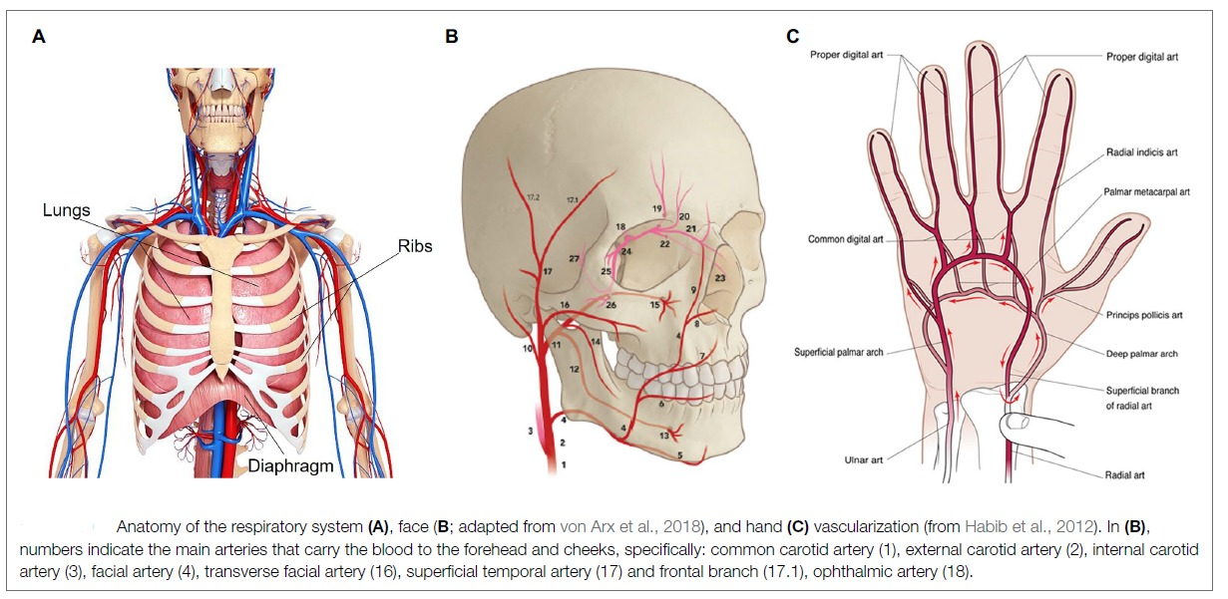
Medical Research
Cardiovascular physiology and anatomy
Hemoglobin role
Blood flow
Notes:
1. Understanding cardiovascular physiology and anatomy is crucial for comprehending heart rate and the circulatory system
2. Knowledge of hemoglobin and its role in determining heart rate is essential for developing a remote monitoring system
3. Photoplethysmography relies on understanding concepts related to blood flow and hemoglobin for accurate measurements
4. Non-medical professionals may face difficulties in researching medical information, including understanding complex vocabulary and evaluating source reliability

Slide 25
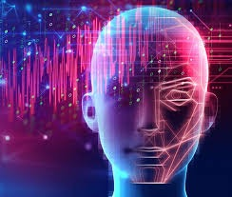
Imaging Processing
Lack of basic knowledge in image processing
Choosing the right image processing method
Balancing real-time requirements – accuracy
Notes:
1.Research is necessary to understand image processing methods used in heart rate monitoring systems
2.Literature and academic research should be examined for algorithms related to heart rate detection, including PPG, color-based analysis, and motion estimation methods
3.A spiral research methodology is employed, exploring multiple techniques and evaluating options from various perspectives
4.Quick response times and computational efficiency are prioritized in selecting pulse detection methods for the system
5.Consideration is given to the complexity, resource efficiency, and trade-off between accuracy and computational complexity
6.Balancing these factors is crucial to meet real-time requirements of the pulse detection system

Slide 26
Thanks for listening, Any questions?

